Slide 1
The Document Object Model
(DOM)
&
Event Driven Programming

Slide 2
AGENDA

Slide 3
Agenda
Overview of DOM
Selecting DOM Elements
Changing and Manipulating the DOM
Event Driven Programming and Events
Mouse Events
Keyboard Events
Timers
Traversing the DOM
Event Bubbling and Event Delegation
APIs and REST
Asynchronous Operation & Promises

Slide 4
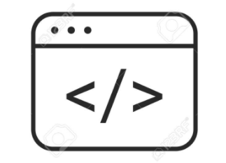
WEB APPLICATION
A web application is a computer program or app that utilizes web browsers and web technology to perform tasks over the Internet.
In simplicity, it is a special type of website that perform functionality

Slide 5
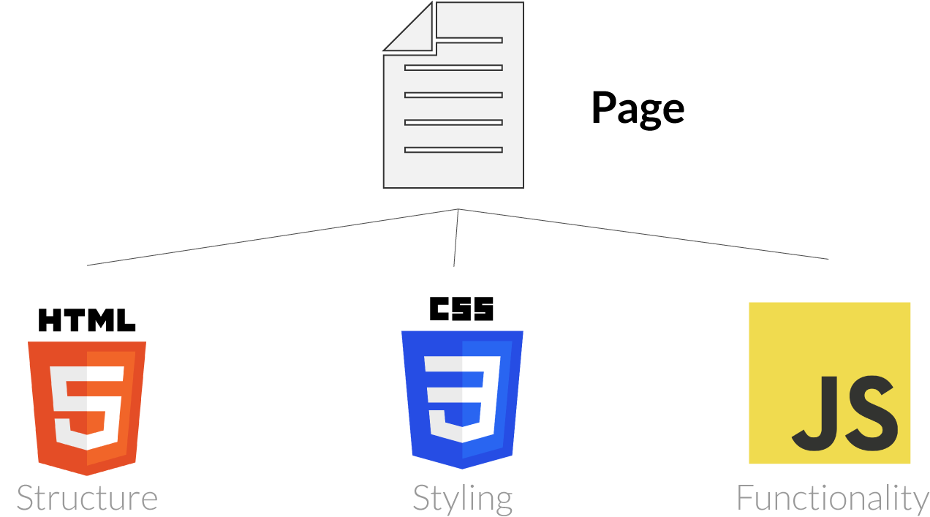
MAIN FRONT-END TECHNOLOGIES

Slide 6
Review of JavaScript?

Slide 7

What is JavaScript?
JavaScript is programming language.
It is a very popular programming language and right now it is one of the most used and most learnt programming language in the world.
It is high-level language
It is a loosely typed language.

Slide 8
In what context we have used JavaScript thus far?

Slide 9
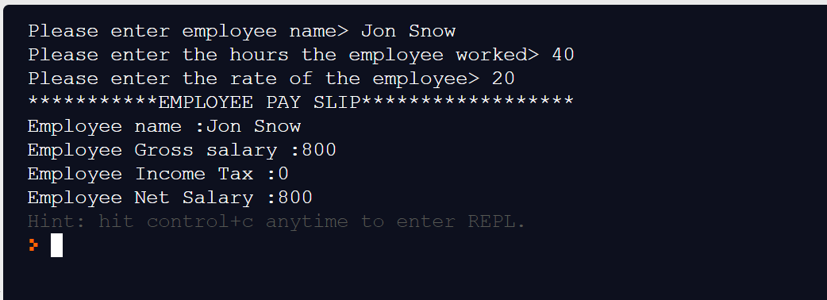
To Build Console Applications

Slide 10
IN MODERN DEVELOPMENT :
WE DON’T USE JAVASCRIPT TO BUILD CONSOLE APPLICATIONS

Slide 11
IN MODERN DEVELOPMENT, WE USE JAVASCRIPT TO BUILD INTERACTIVE WEB APPS WITH PRETTY USER INTERFACES

Slide 12
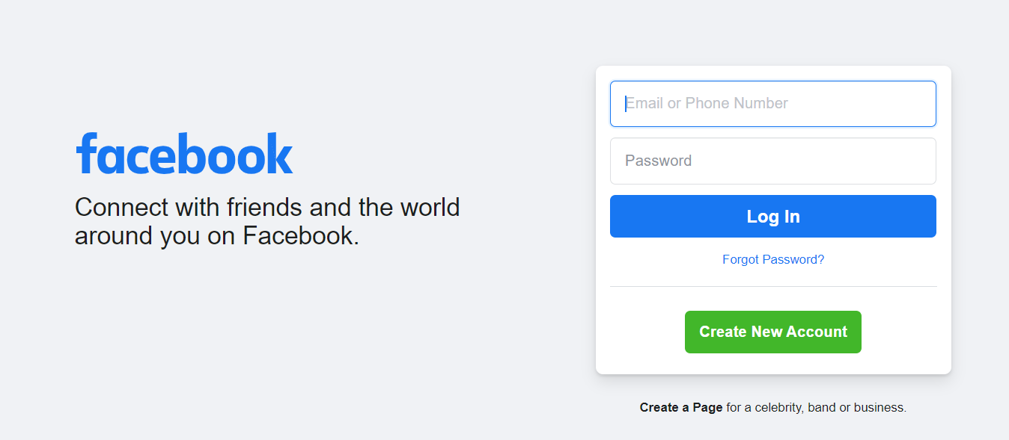

Slide 13
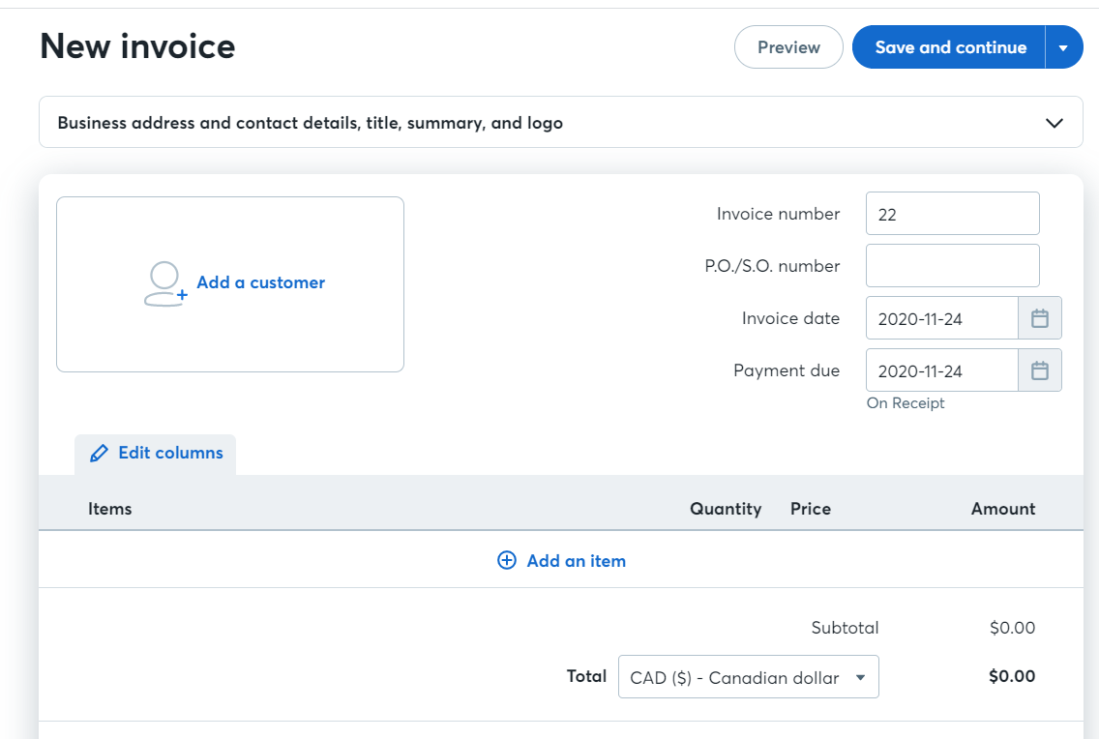

Slide 14
WHAT CAN WE ACTUALLY BUILD WITH JAVASCRIPT?

Slide 15
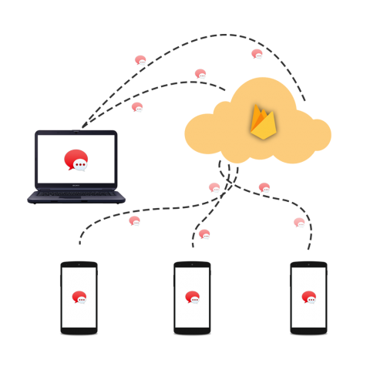

What can you do with JavaScript today?
In modern development, JavaScript can build :
Web Apps
Mobile Apps
Real-Time Networking Apps (Like a chat app)
Games

Slide 16
WHAT WE CAN BUILD WITH JAVASCRIPT DEPENDS ON WHERE THE JAVASCRIPT IS RUNNING OR THE PLATFORM

Slide 17
JAVASCRIPT PLATFORMS/ HOST ENVIRONMENT

Slide 18
JavaScript Platform Overview
For JavaScript, a platform may be a browser, or a web-server or another host, even a “smart” coffee machine, if it can run JavaScript.
Each of “platform” provides platform-specific functionality. The JavaScript specification calls that a host environment.
A host environment provides own objects and functions additional to the language core.
Web browsers give a means to control web pages. Node.js provides server-side features, and so on.

Slide 19
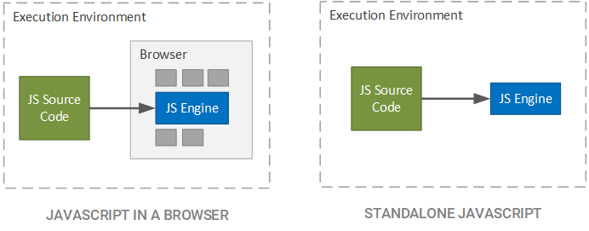
Where does JavaScript code run?

Slide 20
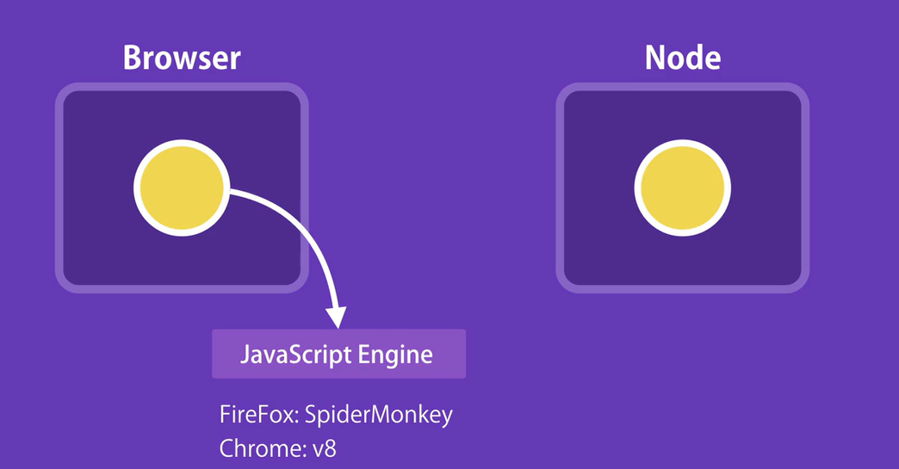

Slide 21
FOR THIS COURSE/MODULE, WE WILL BE LEARNING TO BUILD SIMPLE WEB APPS AND/OR CLIENT BASED WEB APPLICATIONS. THUS, WE WILL ONLY BE WRITING JAVASCRIPT THAT EXECUTES ON THE BROWSER!

Slide 22
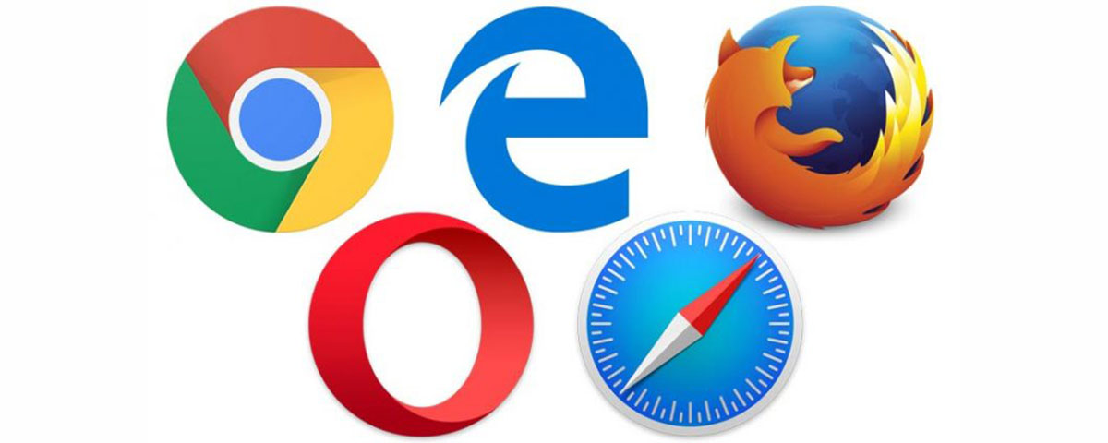
JavaScript in the Browsers

Slide 23
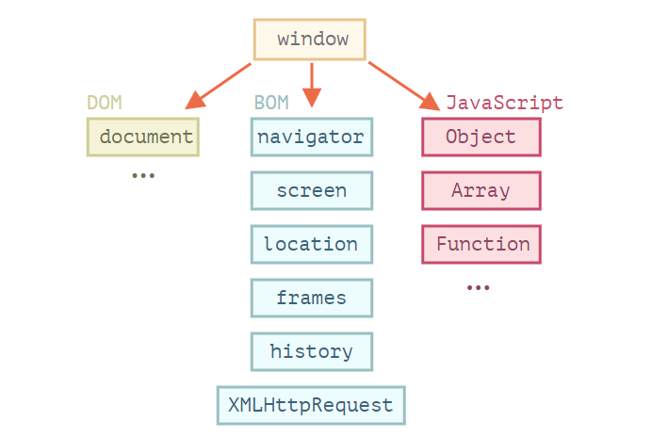

Slide 24
The Document Object Model
(DOM)

Slide 25
What is the DOM?

Slide 26
What is the DOM?
The DOM is a specification explains the structure of a document and provides objects to manipulate it.
The DOM is a set of standardized rules, that tells a programming language, how to access a document and how to access and manipulate the elements within a document.
The DOM is an object-oriented representation of the web page, which can be modified with a scripting language such as JavaScript.
The W3C DOM and WHATWG DOM standards are implemented in most modern browsers.

Slide 27
FROM HTML TO THE DOM

Slide 28
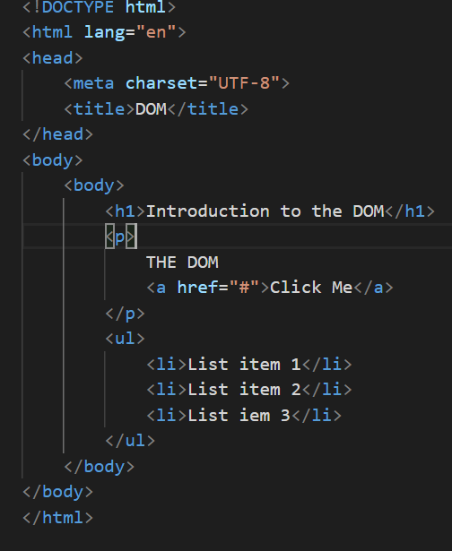
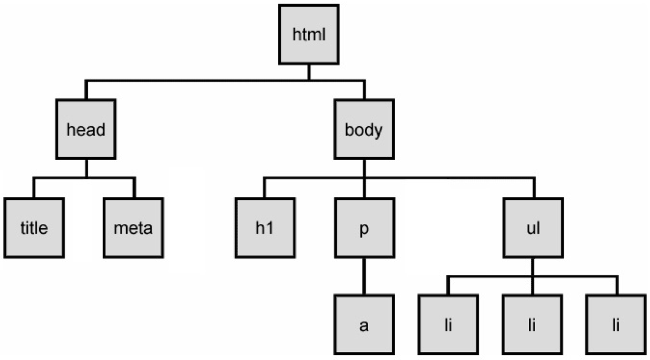
Web pages rely on HTML for their initial structure and content. We write web pages using HTML, and then use web browsers to parse and render that HTML into a living (i.e., modifiable at runtime) tree structure call the DOM Tree.
DOM Tree example:

Slide 29
DOM TREE

Slide 30
DOM TREE
The backbone of an HTML document is tags.
According to the Document Object Model (DOM), every HTML tag is an object. Nested tags are “children” of the enclosing one. The text inside a tag is an object as well.
All these objects are accessible using JavaScript(via the DOM), and we can use them to modify the page.

Slide 31
DOM TREE Continued
Every element in a document—the document as a whole, the head, tables within the document, paragraphs, links, forms, are all part of the document object model for that document, so they can all be accessed and manipulated using the DOM and a scripting language like JavaScript.
The DOM Tree is made up of DOM Nodes, which represent all aspects of our document, from elements to attributes and comments.

Slide 32
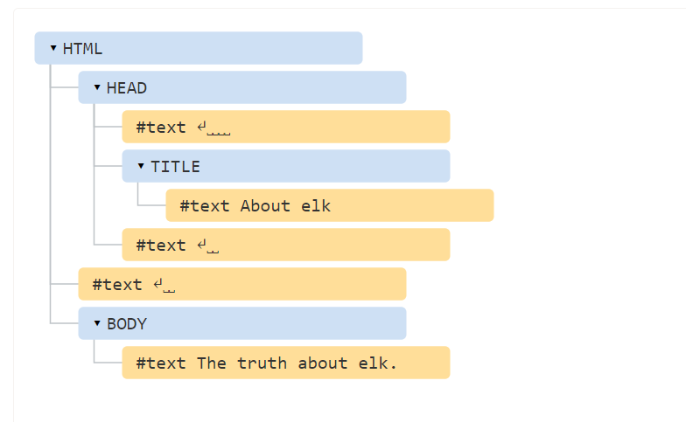
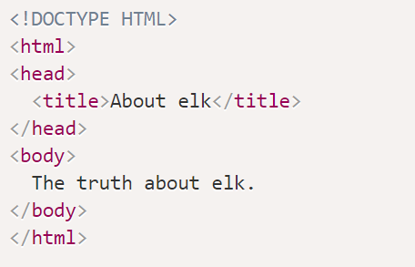

Slide 33
Types of Nodes (The Important ones)
Element- Represents an entity
Attribute- Represents an attribute
Text Node- Represents an attribute

Slide 34
PROGRAMMING THE DOM

Slide 35
PROGRAMMING THE DOM (Continued)
Remember, when you building a web page, HTML defines the initial structure and content of a page, this is static.
However the DOM is the current or actual content of the page as it exists right now in your browser. And this can mean something quite different from the initial HTML used to load the page.
In order to make web pages do things or respond to actions, we use the objects, functions and properties made available to us by the DOM, this is known as Client-side web programming.

Slide 36
PROGRAMMING THE DOM (Continued)
As web programmers we use the DOM via JavaScript to accomplish a number of important tasks:
Finding and getting references to elements in the page
Creating, adding, and removing elements from the DOM tree
Inspecting and modifying elements and their content
Run code in response to events triggered by the user, browser, or other parts of our code
Our entry point to the DOM from JavaScript is via the global variable window. Every web page runs in an environment created by the browser, and that environment includes a global variable named window, which is provided by the browser.
There are hundreds of Objects, methods, and properties available to our JavaScript code via window.

Slide 37
SELECTING ELEMENTS FROM THE DOM

Slide 39
SELECTING ELEMENTS
document.getElementById() -- returns an element whose id attribute/property has the given id String
document.querySelector()-similar to document.getElementById(id), but also allows querying the DOM using CSS selectors for an element that doesn’t have a unique id

Slide 40
TRAVERSING THE DOM

Slide 41
TRAVERSING THE DOM
It is the act of selecting an element from another element.
You can traverse in three directions:
Downwards
Sideways
Upwards

Slide 42
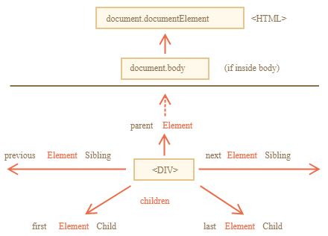

Slide 43
TRAVERSING THE DOM DOWNWARDS
One way of traversing the DOM Downwards is by using document.querySelectorAll()-similar to document.querySelector(selector), but returns all elements that match the selectors as a NodeList:
Another of the ways of traversing the DOM Downwards is by using the children property on a selected elements.
children is a property that lets you select direct descendants (elements that are immediately nested in another element).
It returns a HTML Collection that updates when children elements are changed.

Slide 44
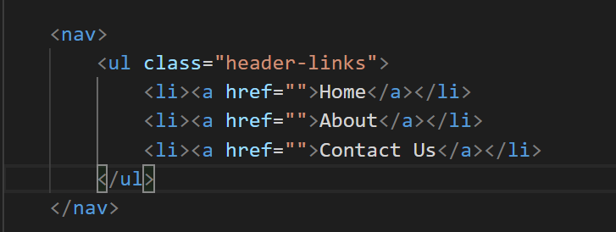
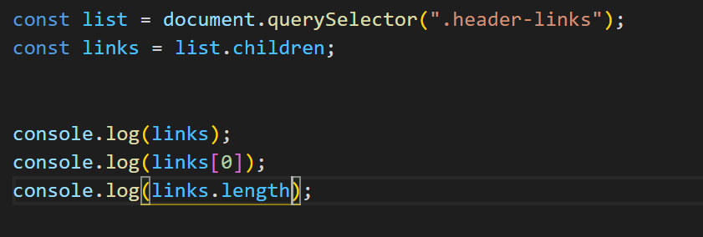

Slide 45
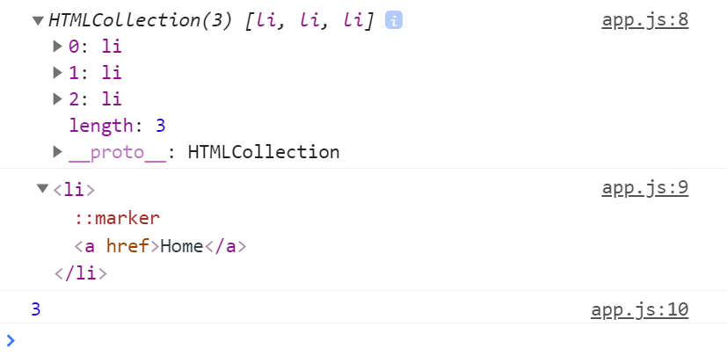

Slide 46
SELECT A SPECIFIC ELEMENT
One of the ways of traversing the DOM Downwards is by using the children property on a selected elements.
children is a property that lets you select direct descendants (elements that are immediately nested in another element).
It returns a HTML Collection that updates when children elements are changed.

Slide 47
TRAVERSING THE DOM SIDEWAYS
The two main ways of traversing the DOM Sideways is by using the nextElementSibling & previousElementSibling property
You can select the next element with nextElementSibling and you can select the previous element with previousElementSibling.

Slide 48
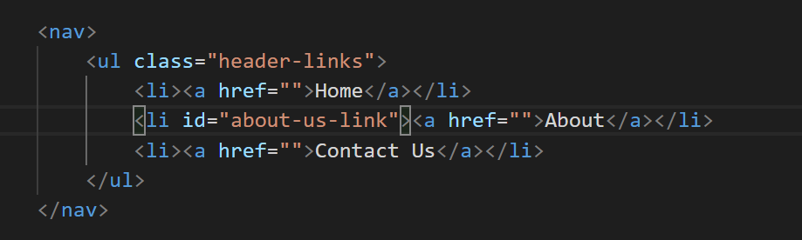
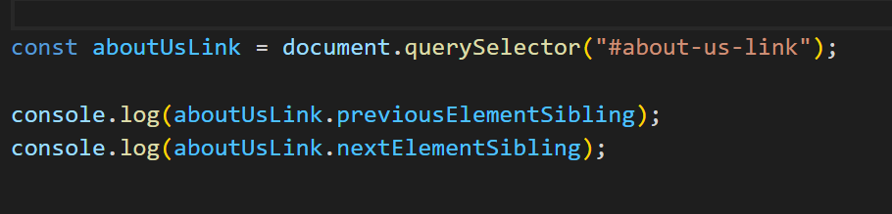

Slide 49
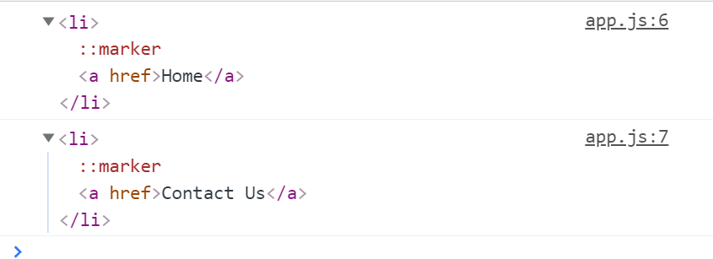

Slide 50
TRAVERSING THE DOM UPWARDS
One of the ways of traversing the DOM upwards is by using the parentElement property on a selected elements.
parentELement is a property that lets you select the parent element. The parent element is the element that encloses the current element.

Slide 51
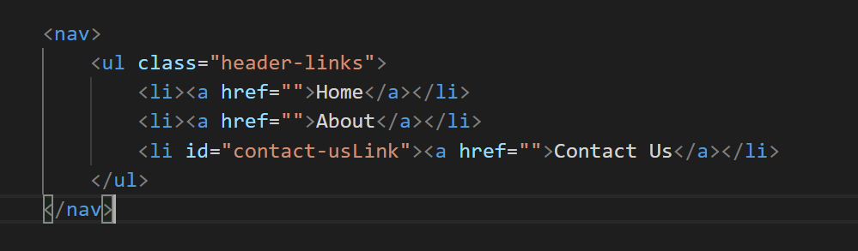
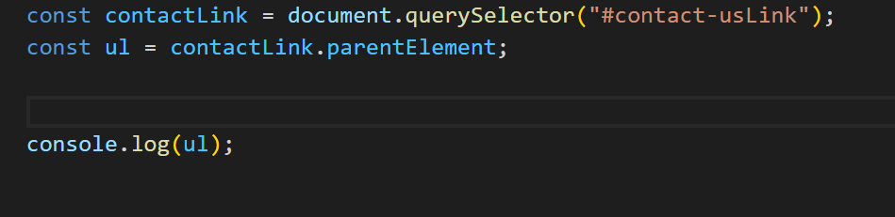

Slide 52
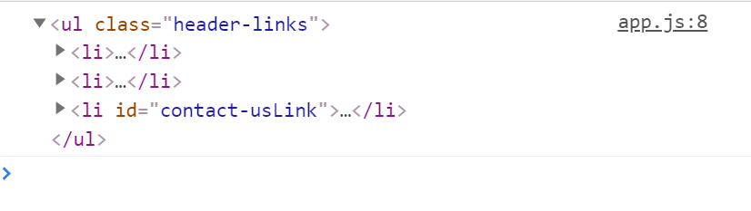

Slide 53
MODIFYING THE DOM

Slide 54
CREATING ELEMENTS IN THE DOM

Slide 55
Creating New Elements
document.createElement(tag) – creates an element with the given tag
document.createTextNode(value) – creates a text node (rarely used)
elem.cloneNode(deep) – clones the element, if deep==true then clone element with all descendants. If deep ==false then clone element and no descendants
The above methods create the new nodes, but do not place them into the page. To do that, we first need to find the correct position within the existing DOM tree, and then add our new node. We have to be clear where we want the new element to get placed in the DOM.

Slide 56
INSERTING & REMOVING ELEMENTS FROM THE DOM

Slide 57
INSERTING AND REMOVING FROM THE DOM
node.append() – this insert node at the end
node.prepend() – this insert node at the beginning
node.before() –- insert right before node
node.after() –- insert right after node
node.remove() –- remove the node.

Slide 58
EXERCISE :
I want you to create an empty <ol> </ol> tag in your html.
Your job is to dynamically create list items inside of the <ol> that you created in the html.
The number of <li> you create will be based on a value you supply to a variable declared in your code

Slide 59
CREATING DOM ELEMENTS USING
INNERHTML

Slide 60
innerHTML
The innerHTML property allows you to get the HTML inside the element as a string. You can also modify it. So it’s one of the most powerful ways to change the page.

Slide 61
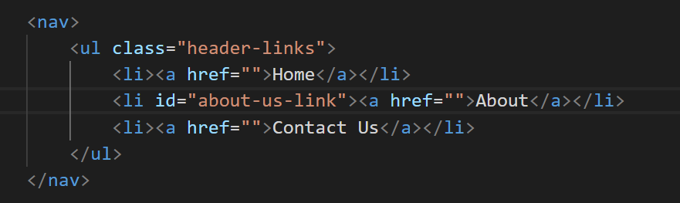
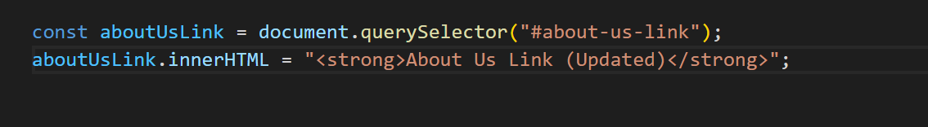


Slide 62
ATTRIBUTES AND PROPERTIES

Slide 63
ATTRIBUTES AND DOM PROPERTIES
When the browser loads the page, it “parses”(reads) the HTML and generates DOM objects from it.
For element nodes, most standard HTML attributes automatically become properties of DOM objects.
For instance, if the tag is <body id="page">, then the DOM object has body.id="page".
For example, if the tag is <img src=”” > then the DOM object has img.src

Slide 64
ATTRIBUTES AND DOM PROPERTIES
All attributes are accessible by using the following methods:
elem.hasAttribute(name) – checks for existence.
elem.getAttribute(name) – gets the value.
elem.setAttribute(name, value) – sets the value.
elem.removeAttribute(name) – removes the attribute

Slide 65
Manipulating CSS Styles

Slide 66
Manipulating CSS
There are generally two ways to style an element using the DOM and Javascript
Create a class in CSS and add it: <div class="...">
Write properties directly into style: <div style="...">.
JavaScript can modify both classes and style properties.
The industry standard is that you should always prefer CSS classes to style.
The latter should only be used if classes “can’t handle it”.

Slide 67
Manipulating CSS using classList
Changing a class is one of the most often used actions in JavaScript.
The elem.classList is a special object with methods to add/remove/toggle a single class.
If you want to apply css to an element. You can select the element and then add (or remove) an already created css rule to it by doing the following :
elem.classList.add("classname") – adds the class
elem.classList.toggle("classname") – adds the class if it doesn’t exist, otherwise removes it.
elem.classList.remove("classname") – remove the class.
elem.classList.contains("class") – checks for the given class, returns true/false.

Slide 68
Manipulating CSS using the style property
The property elem.style is an object that corresponds to what’s written in the "style" attribute.
For example, eetting elem.style.width="100px" works the same as if we had in the attribute style a string width:100px.
For multi-word property the camelCase is used:
background-color => elem.style.backgroundColor
z-index => elem.style.zIndex
border-left-width => elem.style.borderLeftWidth

Slide 69
TIMERS

Slide 70
TIMERS
A block of JavaScript code is generally executed synchronously. But there are some JavaScript native functions (timers) which allow us to delay the execution of arbitrary instructions:
The setTimeout() function is commonly used if you wish to have your function called once after the specified delay.
The setInterval() function is commonly used to set a delay for functions that are executed again and again, such as animations.

Slide 71
EVENT DRIVEN PROGRAMMING

Slide 72
EVENT DRIVEN PROGRAMMING OVERVIEW

Slide 73
EVENTS DRIVEN PROGRAMMING OVERVIEW
The DOM relies heavily on a concept known as Event-driven programming.
In computer programming, event-driven programming is a programming paradigm in which the flow of the program is determined by events such as user actions (mouse clicks, key presses), sensor outputs,
Instead of writing a program in a strict order, we write functions that should be called in response to various events occurring. Such functions are often referred to as event handlers, because they handle the case of some event happening.

Slide 74
EVENTS

Slide 75
BROWSER EVENTS
An event is a signal that something has happened. All DOM nodes generate such signals (but events are not limited to DOM).
There are TONS of events, however, we will look at the useful DOM events
Events that you can listen for in the DOM

Slide 76
MOUSE EVENTS
click – when the mouse clicks on an element (touchscreen devices generate it on a tap).
dblclick- when the mouse is double click on an element
contextmenu – when the mouse right-clicks on an element.
mouseover -when the mouse cursor comes over /
mouseout – leaves an element.
mousemove – when the mouse is moved.

Slide 77
KEYBOARD EVENTS
keydown when a keyboard key is pressed
keyup – when a keyboard key is released.

Slide 78
FORM EVENTS
submit – when the visitor submits a <form>.
focus – when the visitor focuses on an element, e.g. on an <input>.
blur - when the visitor leaves focus from a previously focused element, e.g. on an <input>.
change- when the user changes the value of an element, e.g, change the option of a dropdown list

Slide 79
DOCUMENT EVENTS
DOMContentLoaded – when the HTML is loaded and processed, DOM is fully built.

Slide 80
EVENT HANDLERS

Slide 81
EVENT HANDLER
To react on events we can assign a handler – a function that runs in case of an event.
Handlers are a way to run JavaScript code in case of user actions.
There are several ways to assign a handler. However, the most modern and common way is to used the DOM method called addEventListener

Slide 82
addEventListener
The syntax to add a handler:
element.addEventListener(event, handler);
event - Event name, e.g. "click".
handler -The handler function.
The syntax to remove a handler:
element.removeEventListener(event, handler);

Slide 83
EVENT OBJECT

Slide 84
EVENT OBJECT
To properly handle an event we’d want to know more about what’s happened. Not just a “click” or a “keydown”, but what were the pointer coordinates? Which key was pressed? And so on.
When an event happens, the browser creates an event object, puts details into it and passes it as an argument to the handler.
Some properties of event object:
event.type - Returns the type of event e.g "click".
event.target - The element that triggered the event.
event.clientX / event.clientY - returns the window-relative coordinates of the cursor, for pointer events.
There are more properties. Many of them depend on the event type: keyboard events have one set of properties, pointer events –

Slide 85
EVENT BUBBLING AND DELEGATION

Slide 86
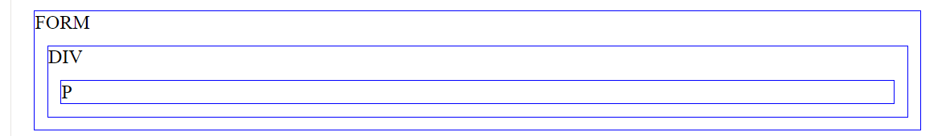
EVENT BUBBLING
When an event happens on an element, it first runs the handlers on it, then on its parent, then all the way up on other ancestors.
A click on the inner <p> first runs onclick:
on that <p>.
Then on the outer <div>.
Then on the outer <form>.
And so on upwards till the document object

Slide 87
EVENT TARGET
A handler on a parent element can always get the details about where it actually happened.
The most deeply nested element that caused the event is called a target element, accessible as event.target.
event.target – is the “target” element that initiated the event, it doesn’t change through the bubbling process.

Slide 88
BROWSER DEFAULT ACTIONS

Slide 89
BROWSER DEFAULT ACTIONS
Many events automatically lead to certain actions performed by the browser.
For instance:
A click on a link – initiates navigation to its URL.
A click on a form submit button – initiates its submission to the server.
Pressing a mouse button over a text and moving it – selects the text.
If we handle an event in JavaScript, we may not want the corresponding browser action to happen, and want to implement another behavior instead.
The main way is to use the event object. There’s a method event.preventDefault().

Slide 90
THE END

